Slide 1

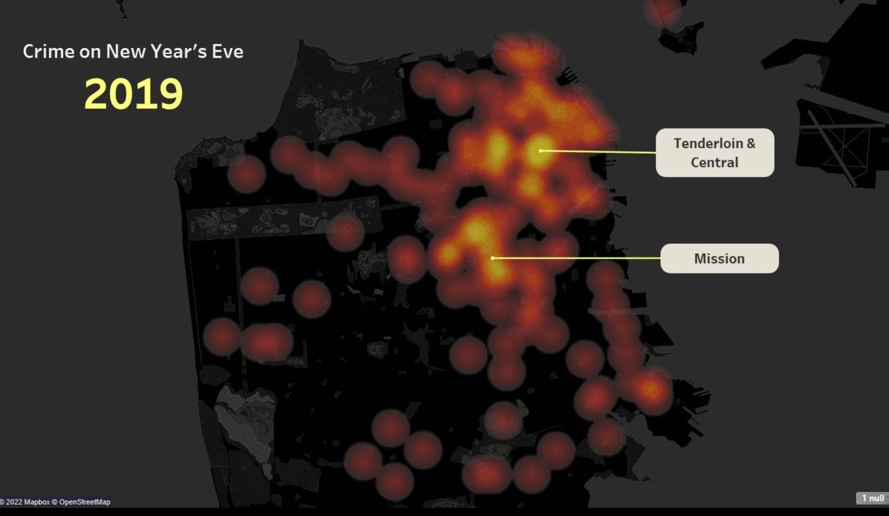
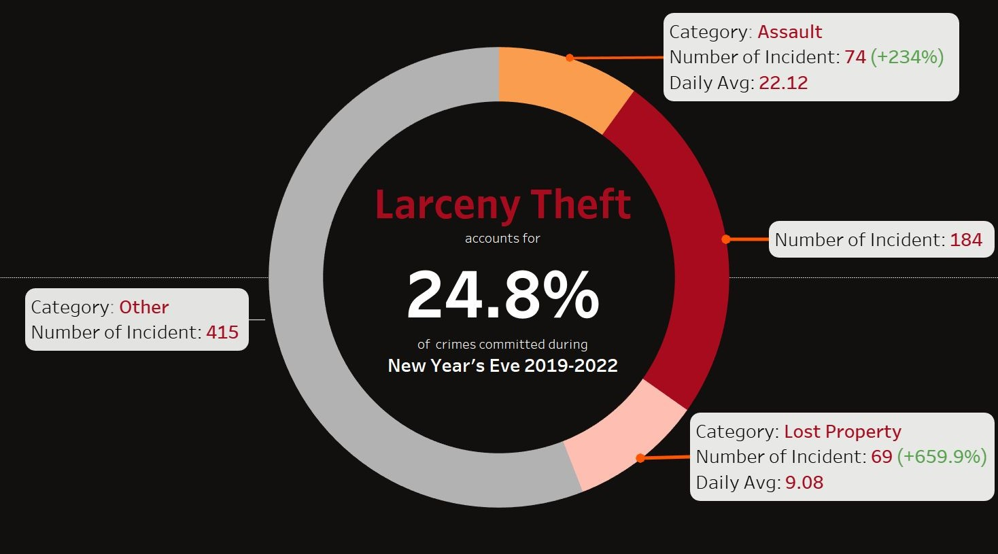
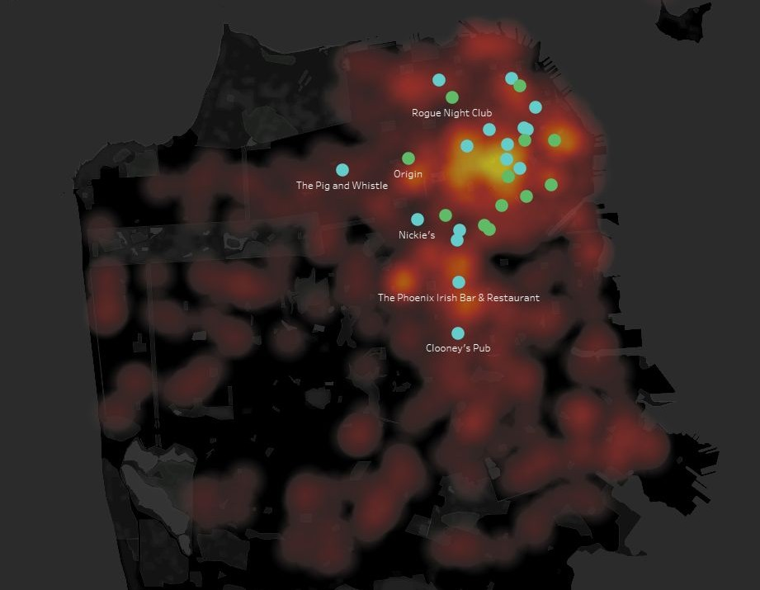
my portfolio.
a sample of data analytics projects that i’ve been working on.
BY : HANG KEsTURI SAID

Slide 2

Taufik
Iskandar
Graduated with Bachelor of Information Systems at University of Amikom Yogyakarta and has Web Development and Data Analysis skills
I decided to join data analytics internship from PT. GIT SOLUTION to enrich my data skill in Query Language such as SQL, Python, and Visualization tools such as Tableau, and sharpen my skill in solving problem with statistical approaches.

Slide 3




SKILLS & ABILITIES
Programming Languages : SQL, Python 3 (Libraries : NumPy, pandas, scikit-learn, Matplotlib)
Visualization Tool
Data Analysis
: Tableau
: Exploratory Data Analysis/Visualization (EDA/EDV), Descriptive Statistics, Cluster Analysis, Correlation Analysis,
Cohort Analysis, Sentiment Analysis
Excel/Sheets : Pivot Table/ Power Query, visualization etc.
Data Storytelling skills

Slide 4

RELEVANT

Slide 5
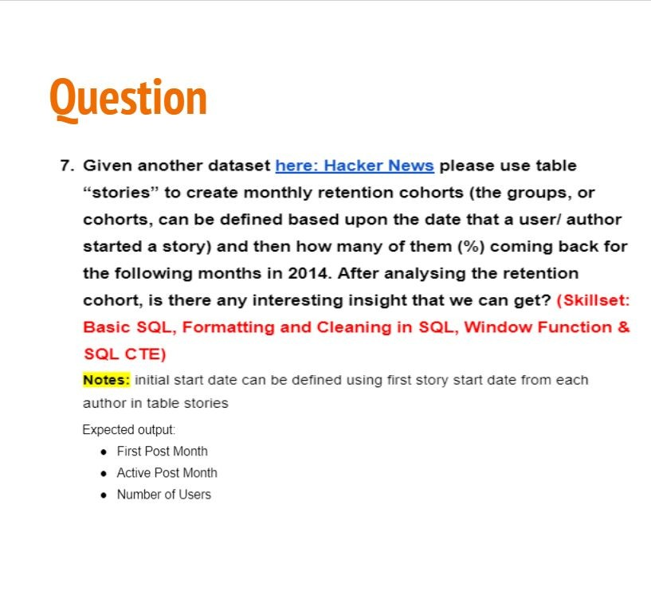
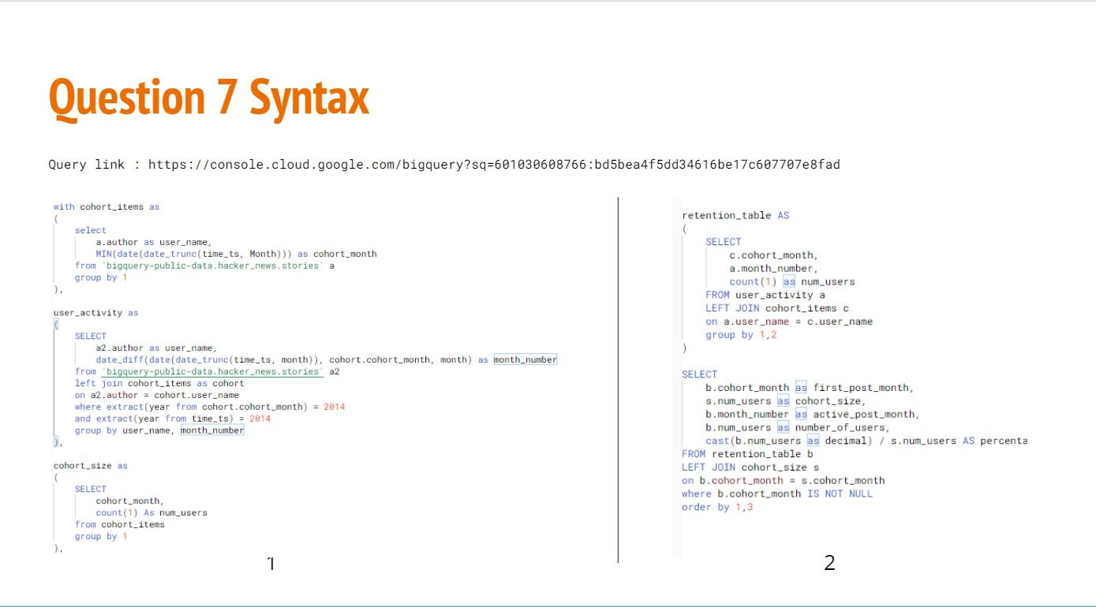
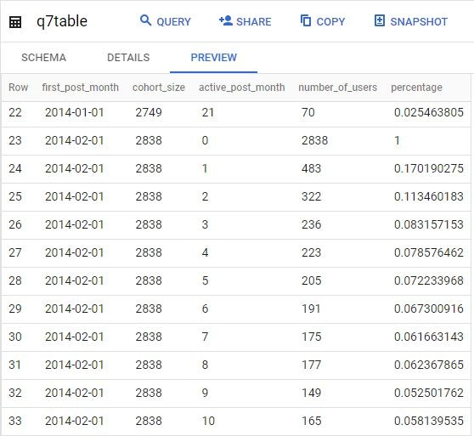
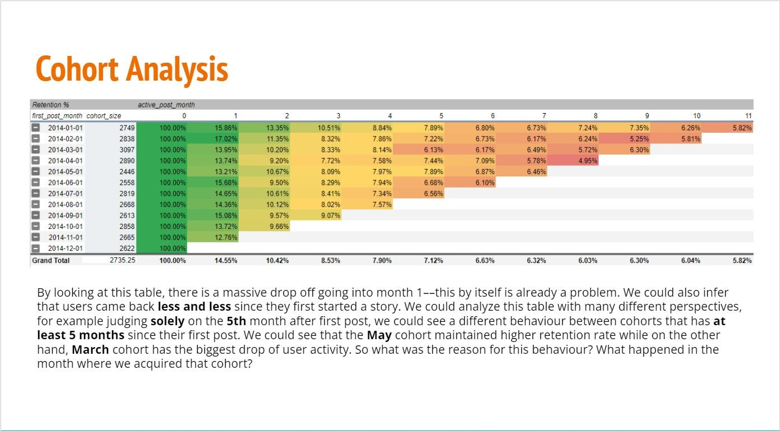
COHORT ANALYSIS (SQL)
Created a monthly retention cohort using Hacker News dataset to know how many (%) of users that returned after creating their first post using SQL in Google Bigquery. Part of RevoU’s Individual Advanced Assignment.
Presentation link

Slide 6
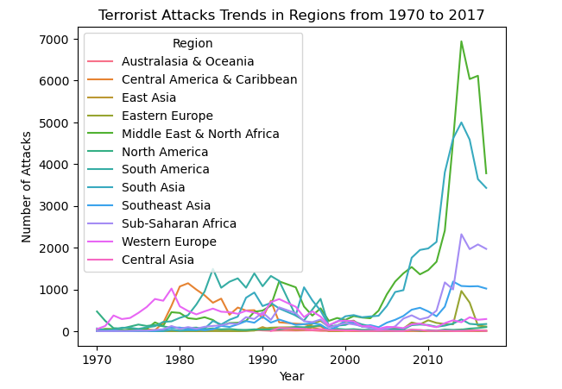
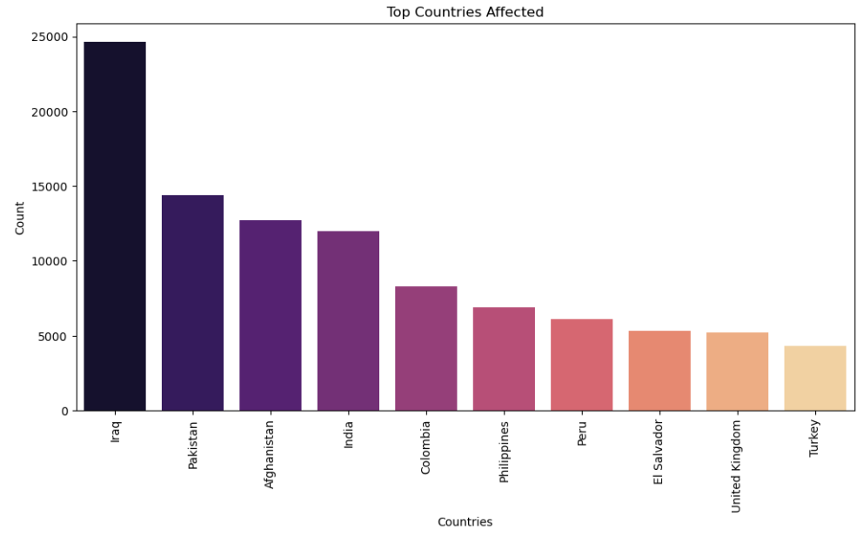
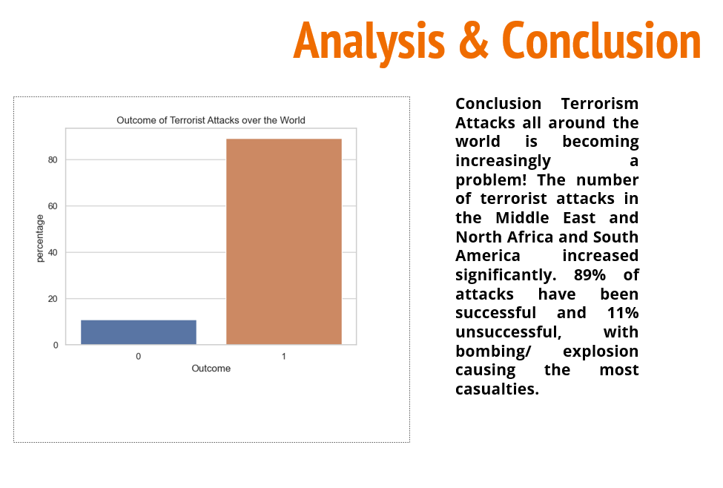
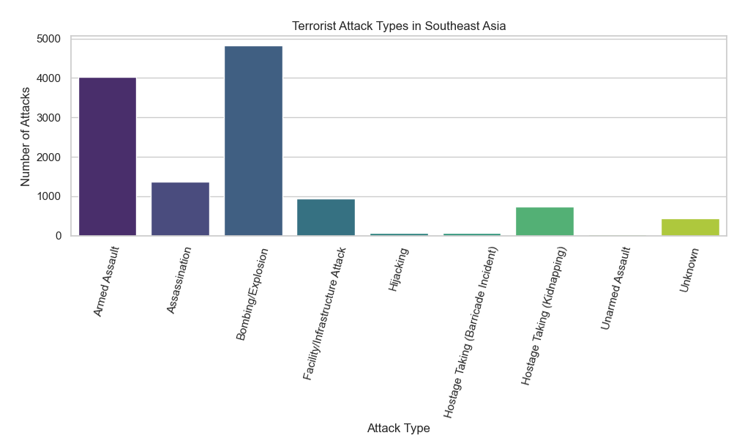
EXAMPLE PROJECT GLOBAL TERRORISM ANALYSIS (PYTHON)
The Dataset about Global Terrorism, dataset including information on terrorist attack around the world from 1970 through 2017, and one conclusion:
Terrorism Attacks all around the world is becoming increasingly a problem! The number of terrorist attacks in the Middle East and North Africa and South America increased significantly. 89% of attacks have been successful and 11% unsuccessful, with bombing/ explosion causing the most casualties.
Presentation link

Slide 7

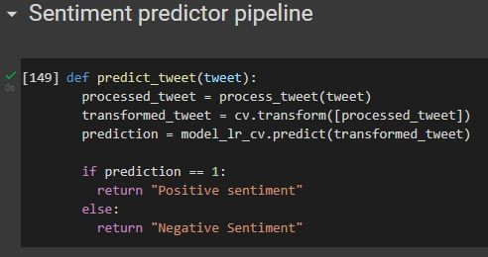
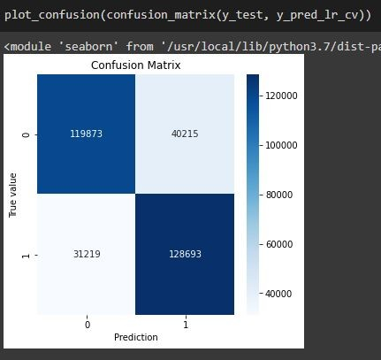

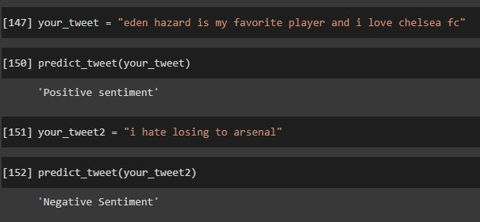
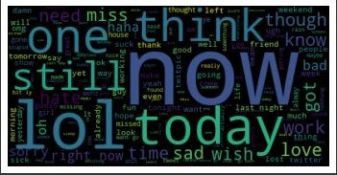
SENTIMENT ANALYSIS (PYTHON)
Created a logistic regression model with 77.68% accuracy using
bag-of-words/count vectorizer method to predict tweet sentiment using tweet data from this dataset (1.6 million data points).
Steps performed :
1. Text Normalization (regex)
POSITIVE
sentiment
NEGATIVE
Tokenization
Stemming (Snowball Stemmer)
Bag-of-Words/Count Vectorizer
Logistic Regression
Google Colab file <- if interested

Slide 8
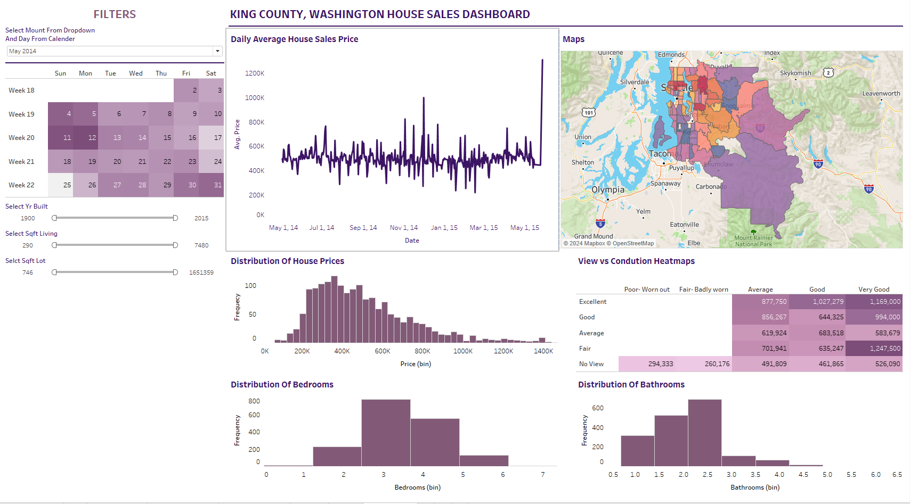
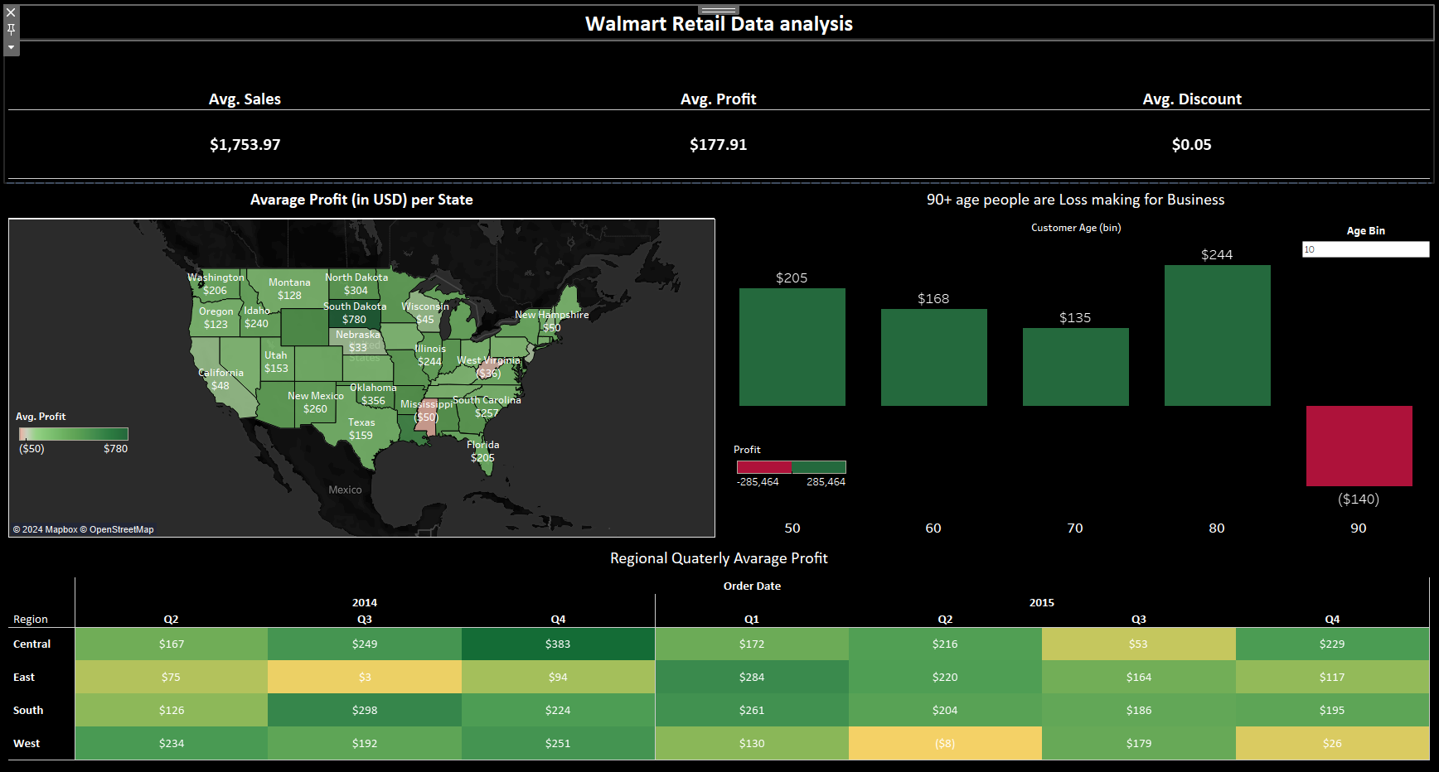
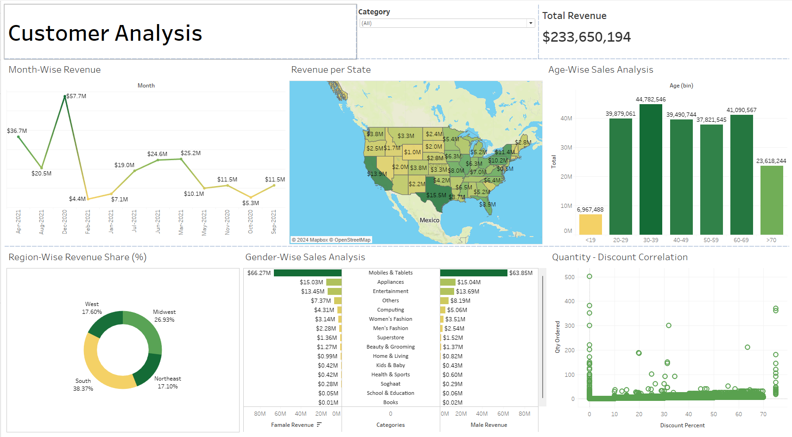
EXAMPLE TABLEAU DASHBOARDS
Ecommerce Sales Dashboard
SF Crime Analysis Dashboard
Airbnb Singapore Listings Dashboard

Slide 9
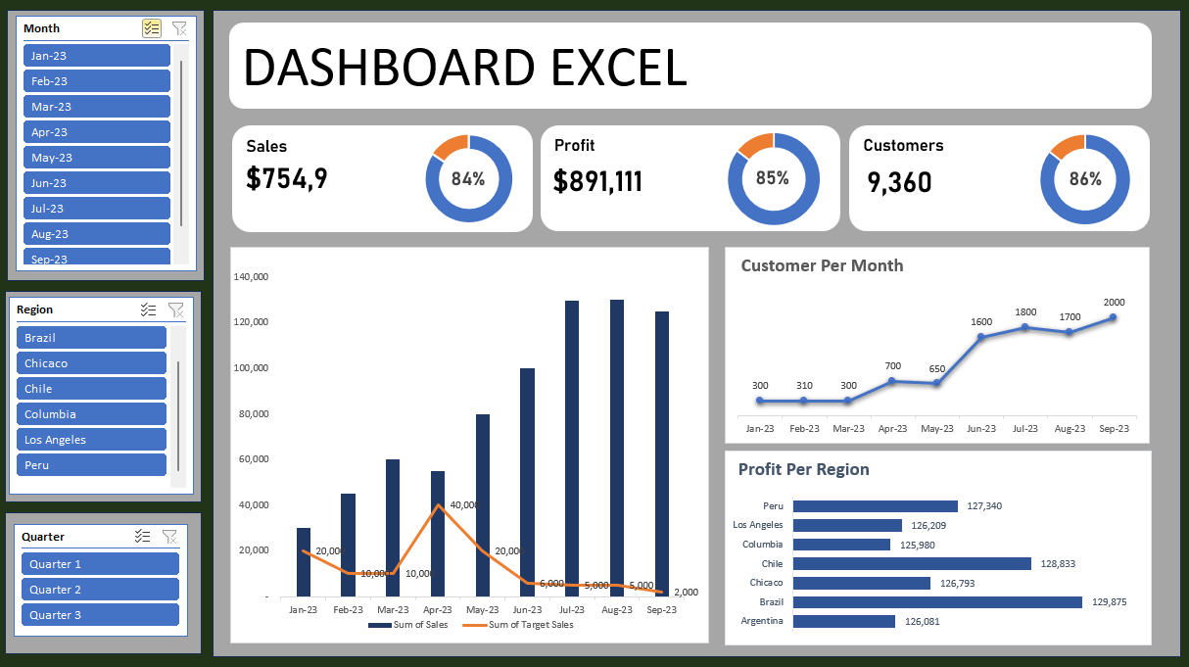
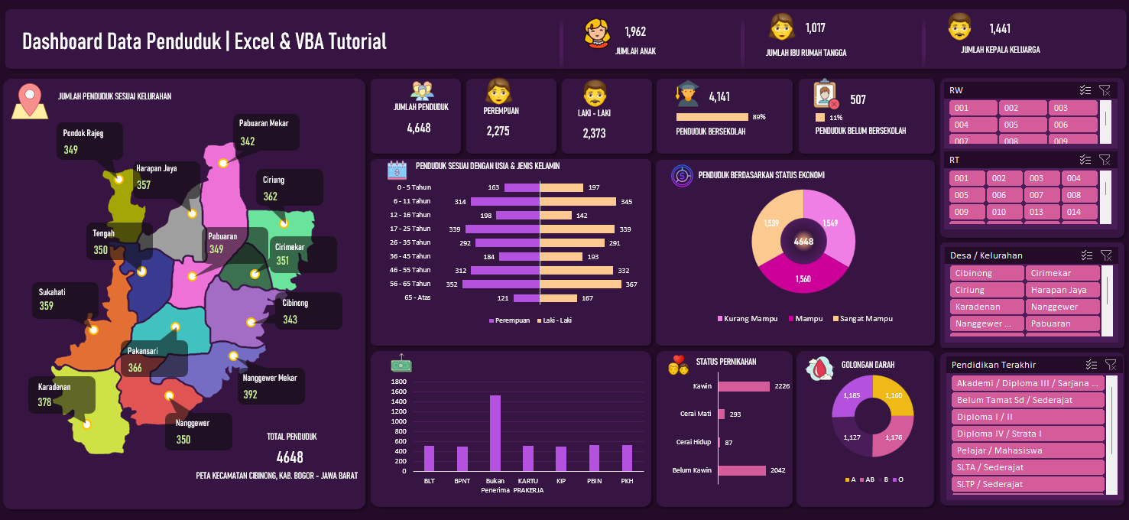
EXAMPLE EXCEL DASHBOARDS
Ecommerce Sales Dashboard
SF Crime Analysis Dashboard
Airbnb Singapore Listings Dashboard

Slide 10


feel free to reach me out!
taufikiskandar293@gmail.com
WA : +62 857 1347 7710 https://www.linkedin.com/in/taufik-iskandar-2253b7200/
CREDITS: This presentation template was created by Slidesgo, including icons by Flaticon, and infographics & images by Freepik
thank you.

